Slide 1
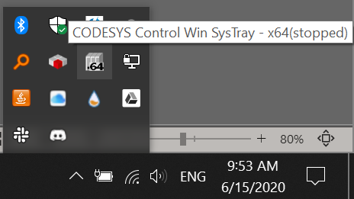
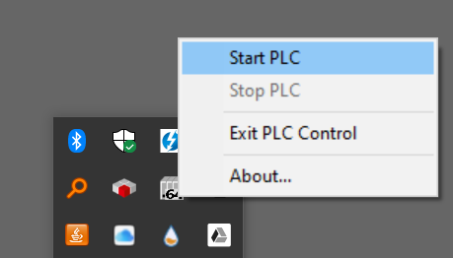
Start the simulated PLC
Open the hidden icons section
Located the simulated PLC Icon
Right click on the icon and then press Start PLC
The simulated PLC will run for 2 hours and then stop itself you must restart it every 2 hours.

Slide 2
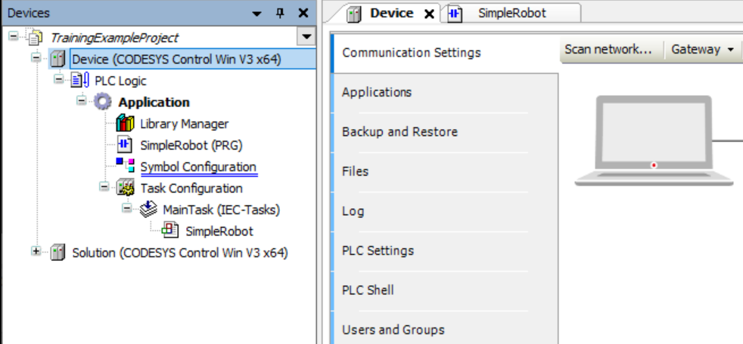
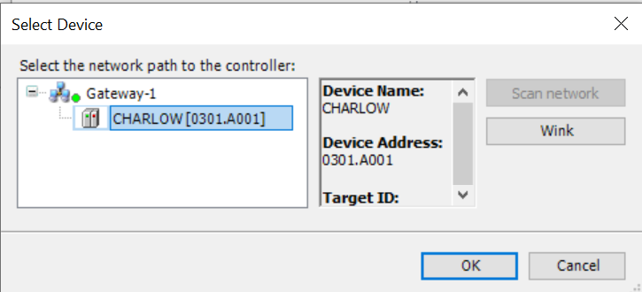
Scan for Device
Double click on the device to open the device window
Press Scan network to scan for the simulated PLC
Select the simulated PLC (It will have the same name as your computer name)
Click ok to connect.

Slide 3
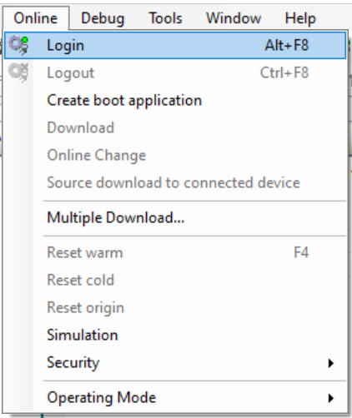
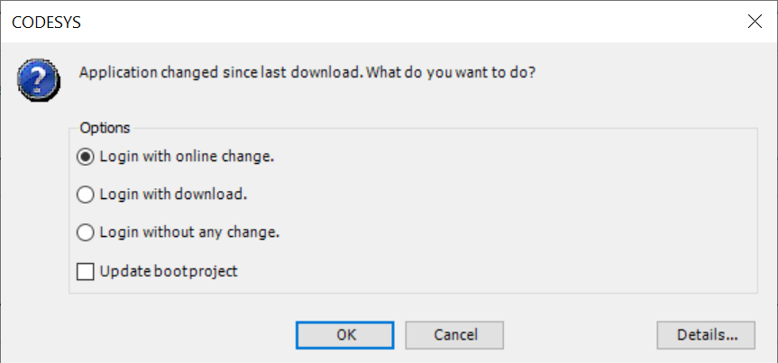
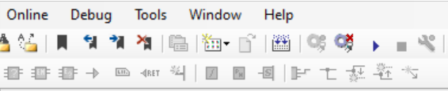
Download a Project to the PLC
When you are ready to test a project select `online -> login` to login to the PLC
If the application you have offline does not match the running application you will be prompted to change the application. For our tests always select `Login with download`
Once the new application is downloaded press Start to run the application

Slide 4
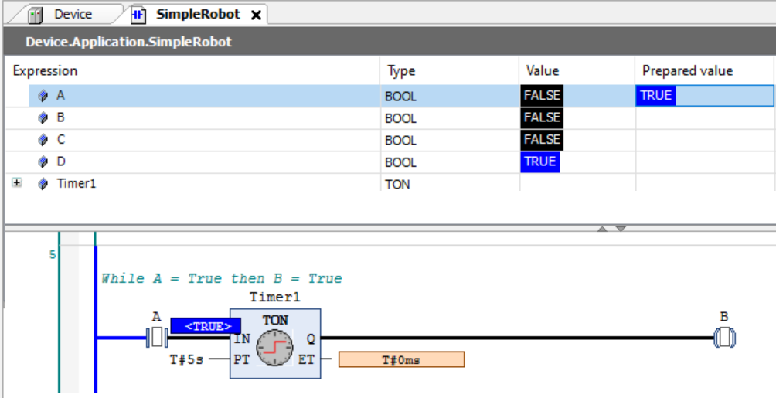
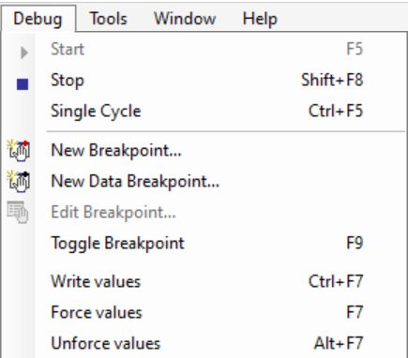
Interact with a running program
You can change values of variables on the PLC by entering a new value in the `prepared value` column or by clicking on the variable in the program
Values prepared can be written or forced using the debug menu
Write sends the new value to the PLC once, Force tries to hold the new value on the PLC

Slide 5
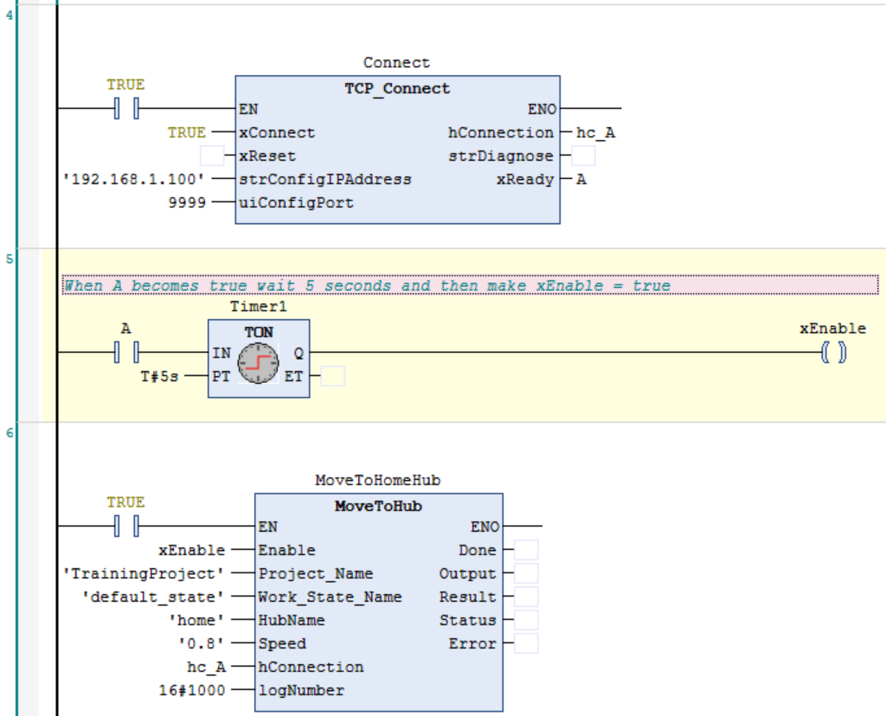
Using RTR Function Blocks
1
RTR controller block that opens a socket and connects to the Realtime Controller
IP address of the Realtime Controller
Port to connect to
Socket information for this connection
Name of the function block (unique for each instance)
Function block type (correlates command sent to Realtime Controller)
Input arguments for the command to be sent to the Realtime Controller (note the socket information ‘hc_A’ which tells the block which socket to use
Output arguments with information returned from the Realtime Controller
4
2
3
5
6
7
8

